Slide 1

Team Trailblazers: Emma, Gauri, Vanshika
Transforming Workplace Culture

Slide 2
[
[
“Women are still underrepresented in leadership, receive less access to senior leaders and are leaving the fastest-growing sectors, such as tech, at 45 percent higher rates than men”
Sara Sanford
What have businesses been doing to address gender inequality?
“How to design gender bias out of your workplace”
2018
Notes:
https://www.ted.com/talks/sara_sanford_how_to_design_gender_bias_out_of_your_workplace/transcript?language=en

Slide 3
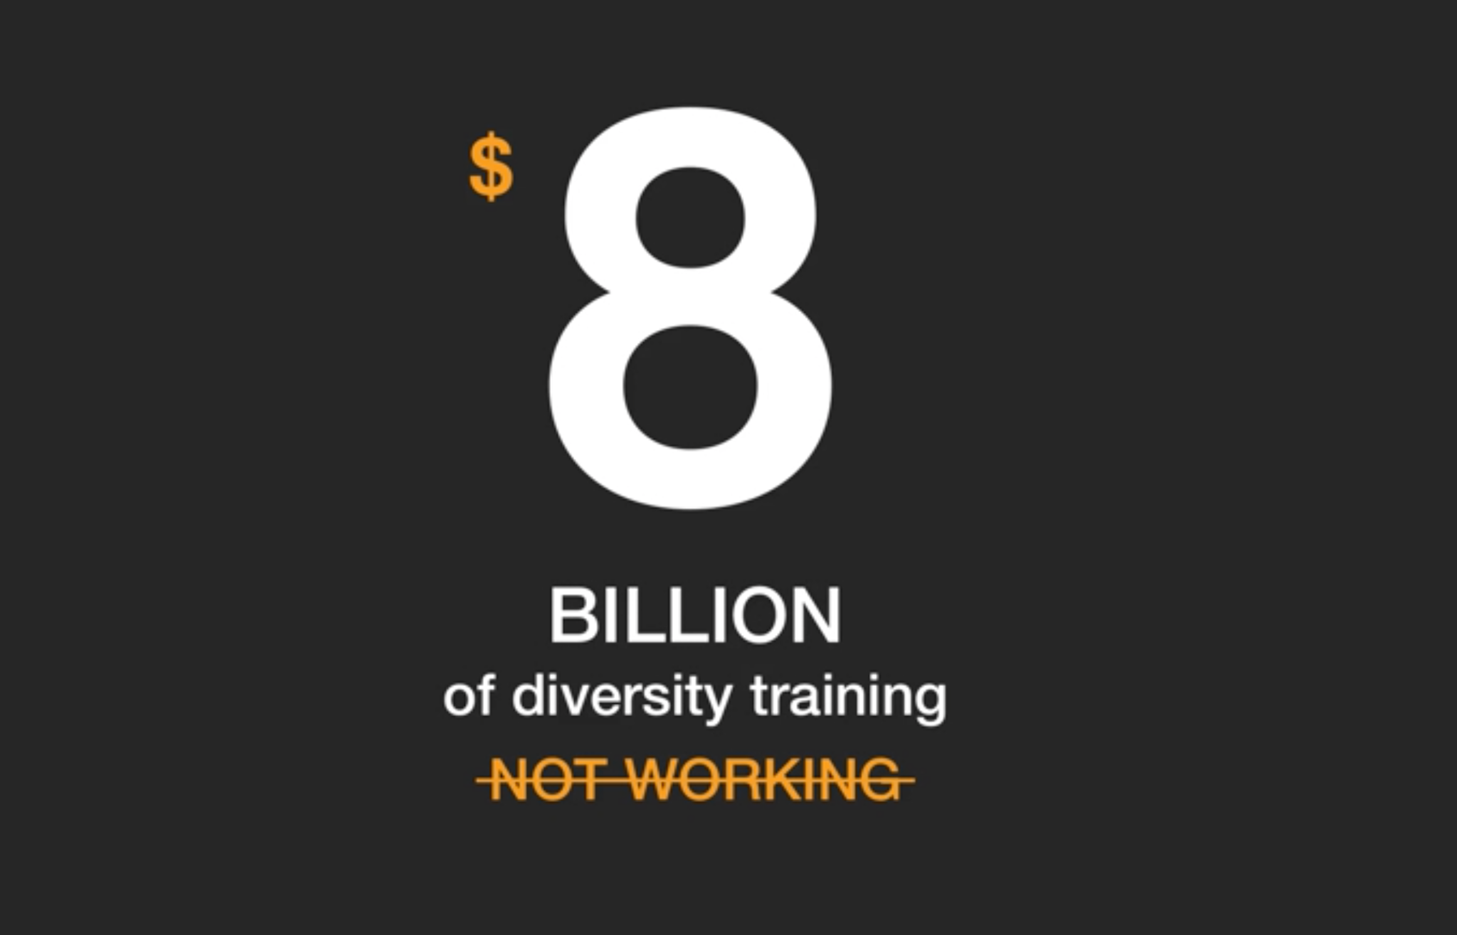
Sara Sanford
“How to design gender bias out of your workplace”
2018
Notes:
Many businesses think they're addressing the problem, because they provide training. Eight billion dollars worth of training a year, according to studies from the "Harvard Business Review." These same studies also conclude that these trainings don't work and often backfire.

Slide 4
Why isn't it working?
Well,
“These approaches fail to address the key systemic problem: Unconscious bias.”
Sara Sanford
[
[
“How to design gender bias out of your workplace”
2018

Slide 5
“Created the first standardized certification for gender equity in US businesses”
- Sara Sanford
“How to design gender bias out of your workplace”
2018
Notes:
Why isn't it working?
Well,
“These approaches fail to address the key systemic problem: Unconscious bias.” – Sara Sanford
Partnered with the University of Washington and created …

Slide 6


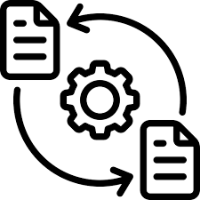

The Opportunity
Working with GEN, we aim to create a data-driven design framework and prototype for a
DEI Dashboard
Project Assignments
Dynamic progress tracking
Document Upload center
Easy Task Management
Notes:
The certification process however is currently very manual, the opportunity our team has is to create a data dashboard for organizations to track their progress in completing the GEN certification.

Slide 7




The Action
Feature Prioritization
Roadmapping
Create!
Competitive Analysis
Literature review
User Interviews
Competitive analysis + Lit review
RICE method to prioritize dashboard features
User interviews-
People who have gone through the process and product experts
Roadmap for the development of the Dashboard

Slide 8
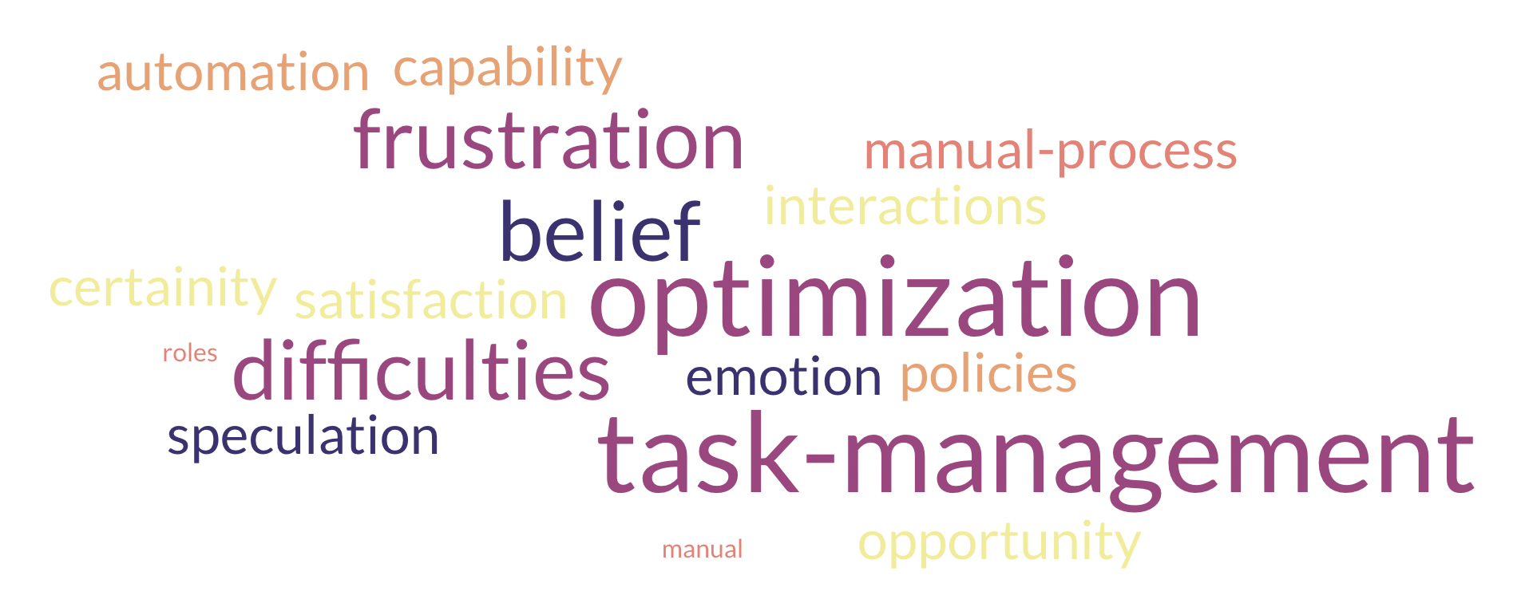
Insights

Slide 9






Features
Dynamic Progress Indicators
Internal Chat Integration
Easy Task Management
Instant Alerts
Task Assignments
External communication Feature

Slide 10
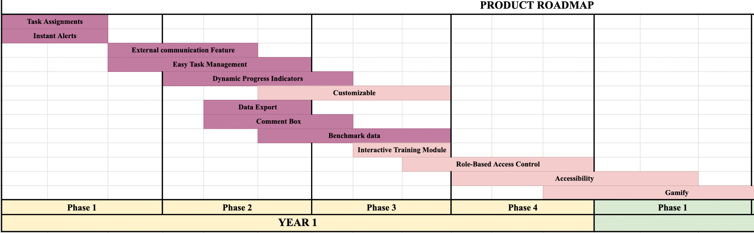
The Strategy
Notes:
Our strategy is our 1-2 year roadmap, where we prioritized our MVP features highlighted in dark pink, completing them in the first year. These essentials set the stage for further enhancements, accelerating our DEI initiatives.

Slide 11





The Outcome
8 prioritized features in MVP Dashboard model
Increased Gender Representation
Cultural Shift
Improved Employee Satisfaction
Competitive Advantage
Notes:
Introducing our MVP DEI Dashboard with 8 prioritized features that can transform the workplace through equal gender representation, fostering a cultural shift. boosting employee satisfaction and giving orgs a competitive edge.

Slide 12
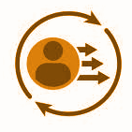







The Impact
Unconscious Bias
Gender Disparities
Isolated Efforts
Reactive Approach
Conscious Inclusion
Gender Equity
Holistic Solutions
Proactive Approach
Notes:
Small tweaks, big changes. Our MVP model shifts from bias to inclusion, fueled by real-time data. Departments unite, driving meaningful change. Saying Hello equity and goodbye disparities!

Slide 13

THANK YOU!
Questions?
Feel free to email additional questions/ comments to
eng223@uw.edu
Notes:
Thank you for joining us today! Our commitment to DEI drives our mission forward continuing this journey towards a more equitable future. Stay connected for more updates!

